Slide 1

Customer analysis
income prediction result
01 July 2021

Slide 2

EXECUTIVE SUMMARY

Slide 3
research background
Although there are significant evidences showing that, younger customers tend to trade more aggressively by carrying higher margin and higher turnover (result from version 1), this report reveals that older customers, usually have greater NAV:
 | Young | Old
Margin usage ratio & Trading turnover | High | Low
NAV | Low | High
Because NAV directly determines how much income one customer could generate to PHS. We attempt to develop a model that takes into account both relative aspects (margin usage ratio & trading turnover) and absolute aspect (NAV) to predict the expected income one new customer could yield over a month.

Slide 4
methodologies predictive tool
LOCATION
REGRESSION &
BOOTSTRAP
FEE INCOME
When a new customer opens an account, there are 4 types of information provided: location, gender, age, and account type (whether or not the customer registers for margin).
GENDER
Based on 4 key inputs, we build a model that predicts monthly income generated by that customer
INTEREST INCOME
AGE
ACCOUNT TYPE
normal customer: who has no margin sub-account
margin customer: who has opened a margin sub-account

Slide 5
KEY FINDINGS: Ho chi minh city
In Ho Chi Minh City, although older customers usually trade less frequently and carry less margin in relative to their NAV, the model indicates that they are still a potential group.
In fact, male normal customers aging from 35 to 55 are predicted to yield approximately 150,000VND monthly trading fee per capita [detail]. Male margin customer in this age group are also predicted to generate 500,000VND-1,100,000VND trading fee per capita [detail], highest over other age groups. Compared to trading fee, interest income apparently follows the same pattern [detail].
In contrast, the pattern is completely different for female customers. The model predicted that either young or old female customers create highest trading/interest income whereas the middle-age falls short behind [detail] [detail].
In general, the oldest groups that age more than 55 are expected to have greatest NAV and hence predicted to produce highest income. However, there is a lot of uncertainties surrounding this expectation because it derives from just a few number of customers who fall in this age group [detail].

Slide 6
KEY FINDINGS: ha noi
In Ha Noi, the model produces great uncertainties in young, female, normal customers due to the lack of customers. However, the expectation of monthly trading fee of this group is predicted to be highest, ranging from 170,000VND to 200,000VND among the group of age 18-25. The male counterpart, in contrast, is predicted to generate highest fee income in the oldest group (age 45-60) [detail].
For margin customers, there is little difference between male and female, the model predicted that customers in their middle age (40-55) generate highest fee income, and females slightly surpass males [detail]. Their monthly trading fee is expected to fluctuate around 800.000VND.
Predicted interest income on each customer also exhibits almost the same pattern which varies from 400.000VND to 500.000VND per month in that age group [detail]. However, as seen clearly in the case of Ho Chi Minh City, older age groups in Ha Noi also imply greater uncertainties [detail] [detail]

Slide 7
KEY FINDINGS: hai phong
In Hai Phong, for those of male customers who have not opened a margin sub-account, there are great uncertainties surrounding our prediction. Despite that, the model suggest that a typical male customer in 35-45 age group has highest expected trading fee, approximate at 170,000VND per month. Male customers are expected to far surpass female customers who are predicted to generate 50,000VND at most in monthly trading fee per capita [detail]
For margin customers, we are quite certain about male customers. The best performers are male customers who age 35-50. This group is predicted to generate 500,000VND-600,000VND in monthly fee income and 300,000VND-400,000VND in monthly interest income. Whereas female customers in the same age group are also expected to generate the same income, the youngest females (age 21-27) and oldest females (age over 55) present higher expected monthly fee/interest income but also expose to a great deal of prediction uncertainties [detail] [detail].

Slide 8
GUIDELINE

Slide 9
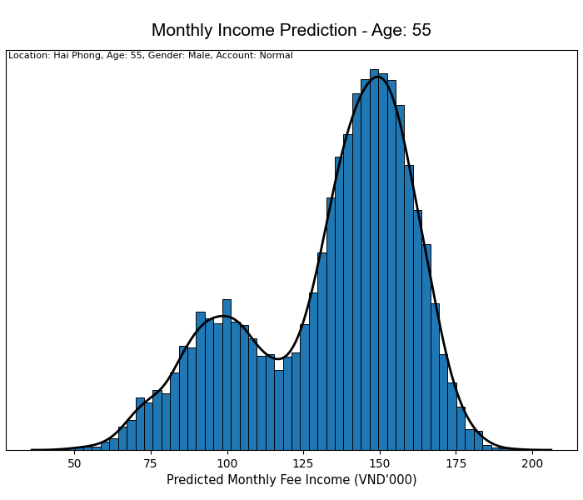
how to read the result: distribution plot on predicted fee income
The distribution plot describes how likely one quantity takes on possible values. Here, it's used to show the possible values of true expected monthly income and how probable they are.
Distribution plots with 2 peaks as seen reveals that there is a divergence in the underlying data that could possibly divide the examined customers into 2 smaller groups. But as you might realize later, customers of same location, gender, and age are usually well described by a single model

Slide 10
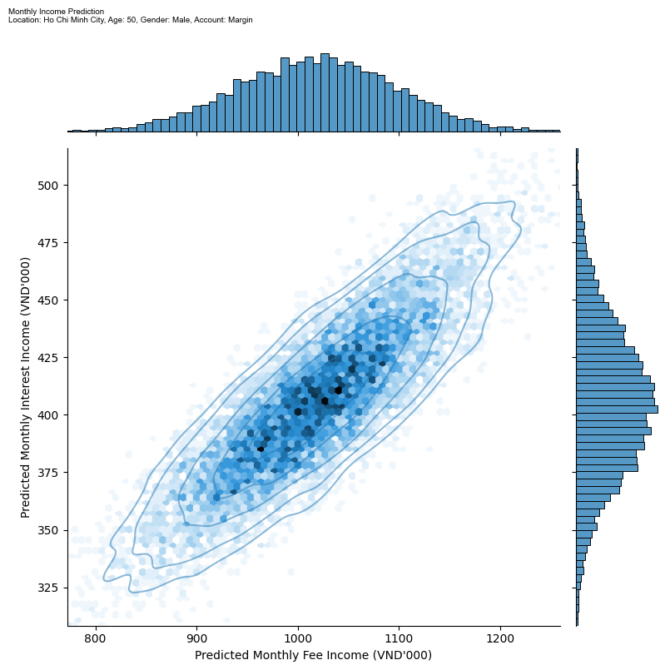
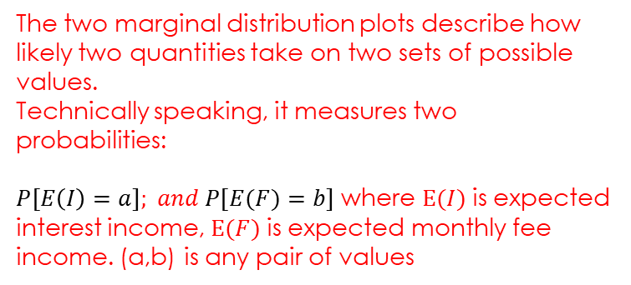
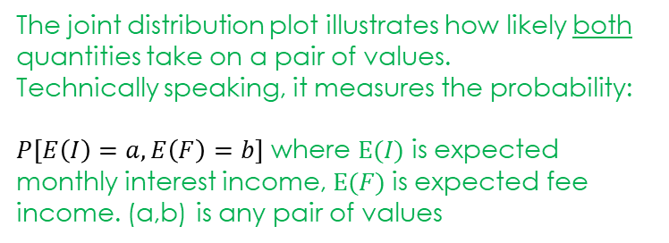
how to read the result: joint Distribution plot on predicted fee income & margin income
The two marginal distribution plots describe how likely two quantities take on two sets of possible values.
Technically speaking, it measures two probabilities:
$P[E\left(I\right)=a]; and P[E(F)=b]$ where $E(I)$ is expected interest income, $E(F)$ is expected monthly fee income. (a,b) is any pair of values
1
2
The joint distribution plot illustrates how likely both quantities take on a pair of values.
Technically speaking, it measures the probability:
$P[E\left(I\right)=a, E\left(F\right)=b]$ where $E(I)$ is expected monthly interest income, $E(F)$ is expected fee income. (a,b) is any pair of values

Slide 11
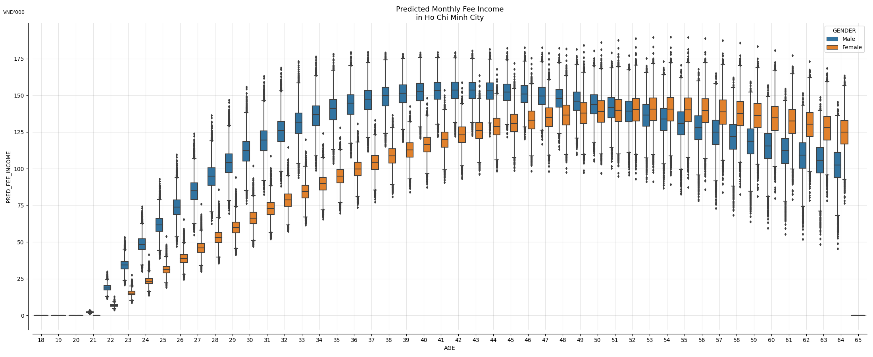
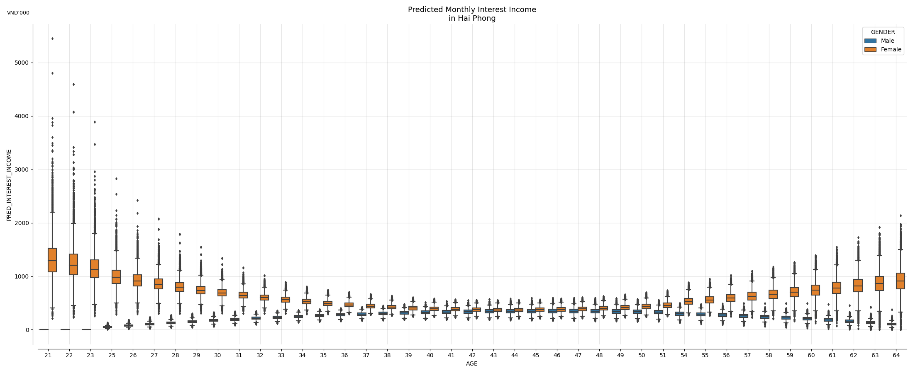
how to read the result: box plot on predicted fee income: Summary result
This box plot summarizes predictive results on Monthly Fee Income in HCMC across genders and ages:
Upside Outliers
25-75 percentile Intervals
Downside Outliers

Slide 12
RESULT OF HO CHI MINH CITY

Slide 13
NORMAL ACCOUNT

Slide 14
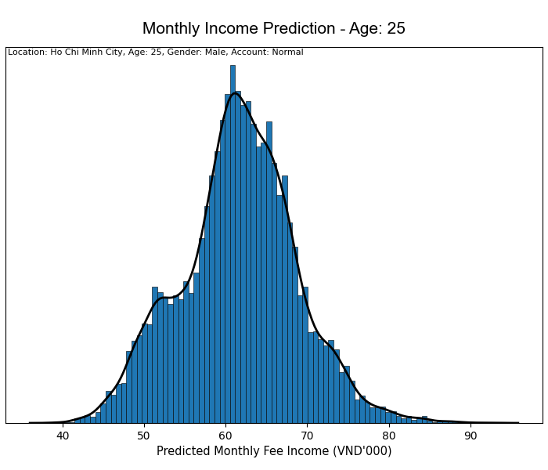
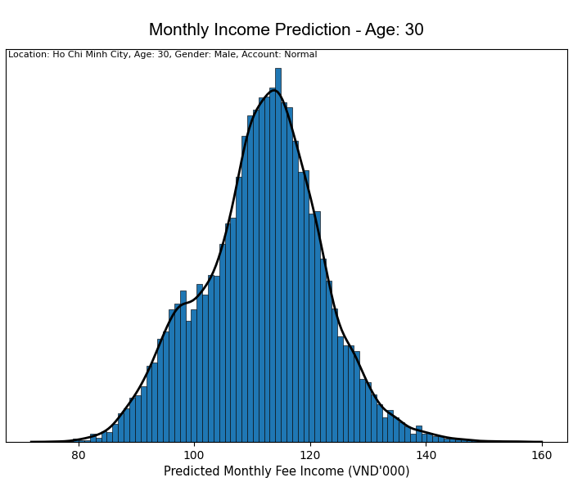
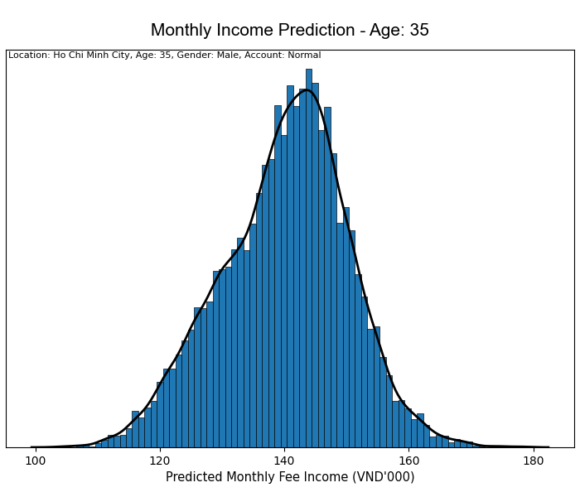
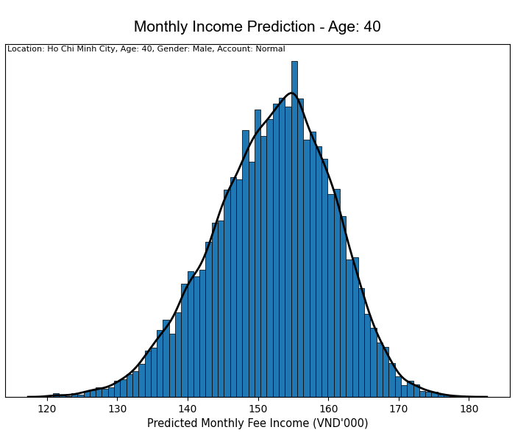
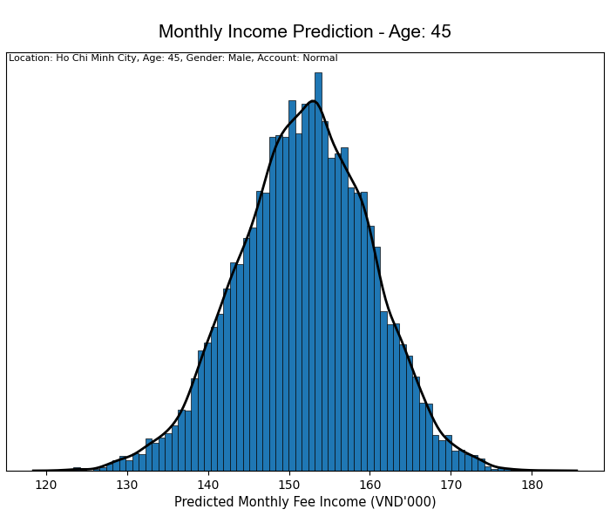
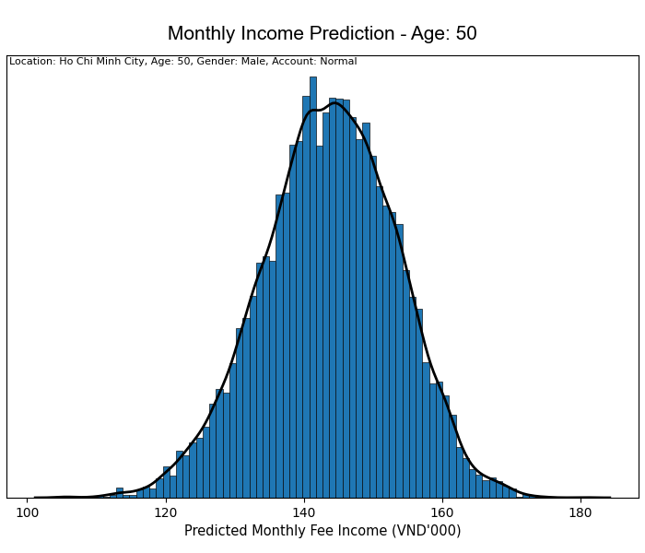
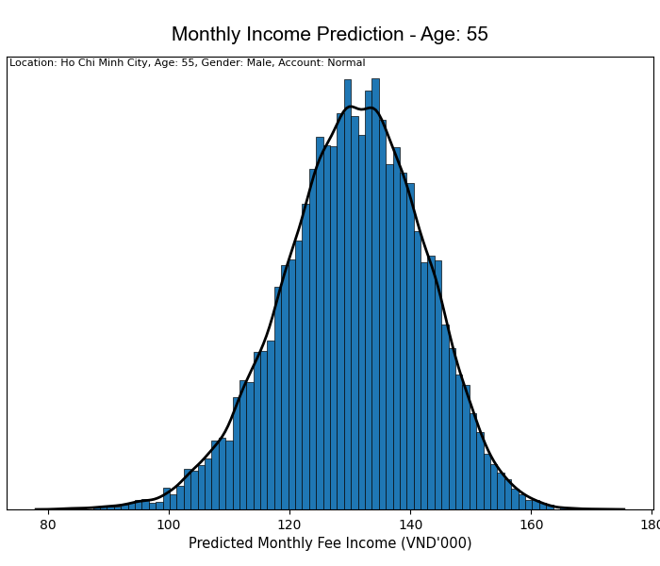

income PREDICTION ACCOUNT TYPE: normal , LOCATION: HO CHI MINH CITY, GENDER: male
click to go back to guideline
click to go back to key findings

Slide 15
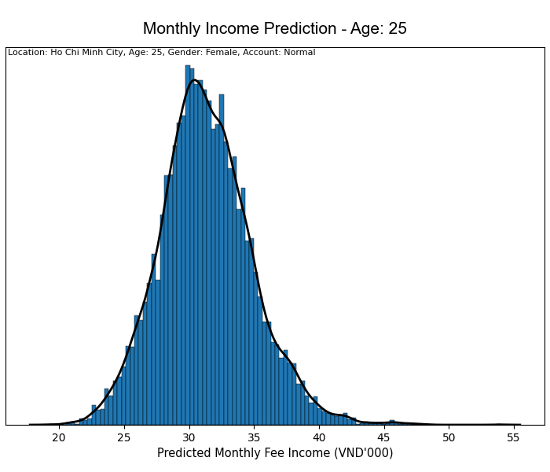
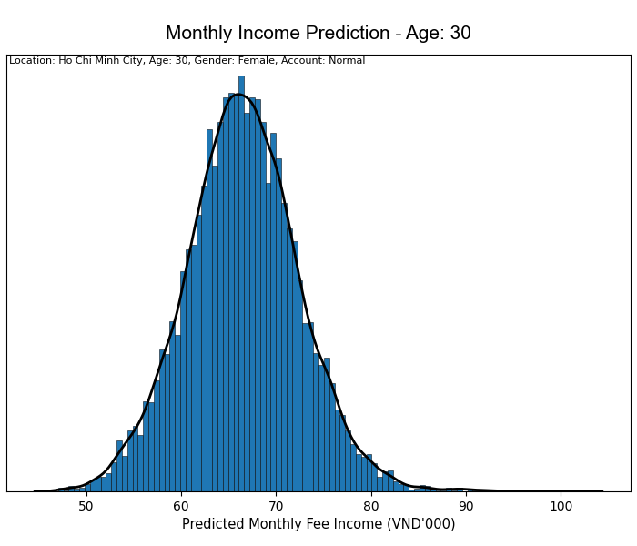
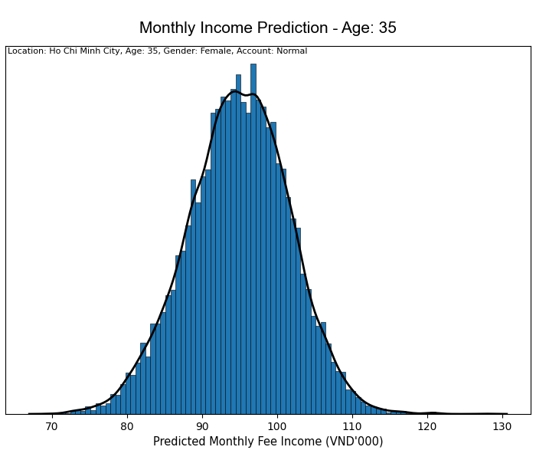
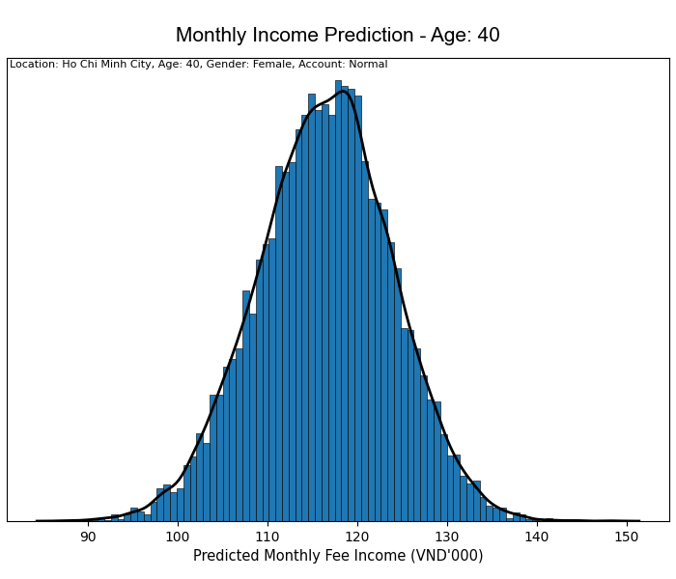
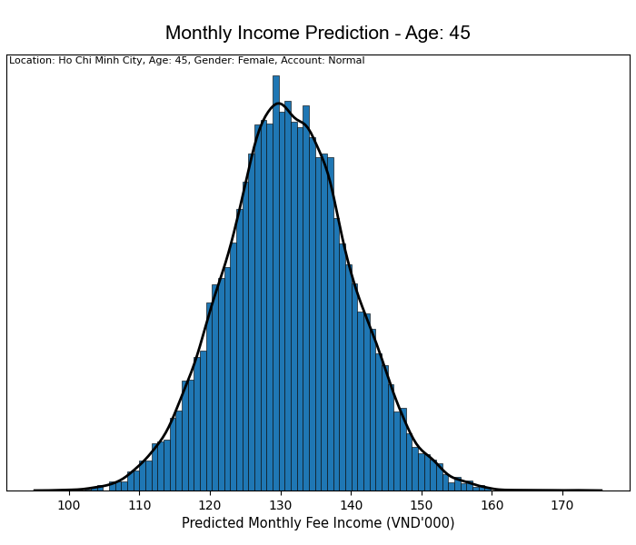
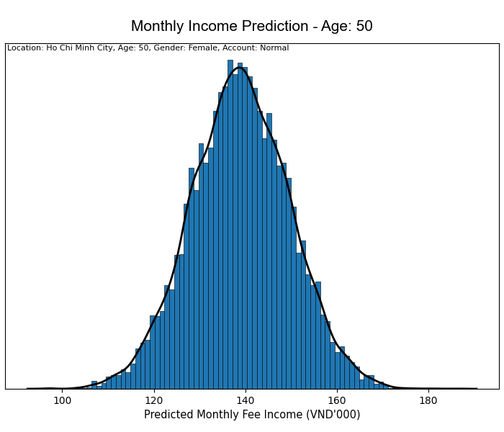
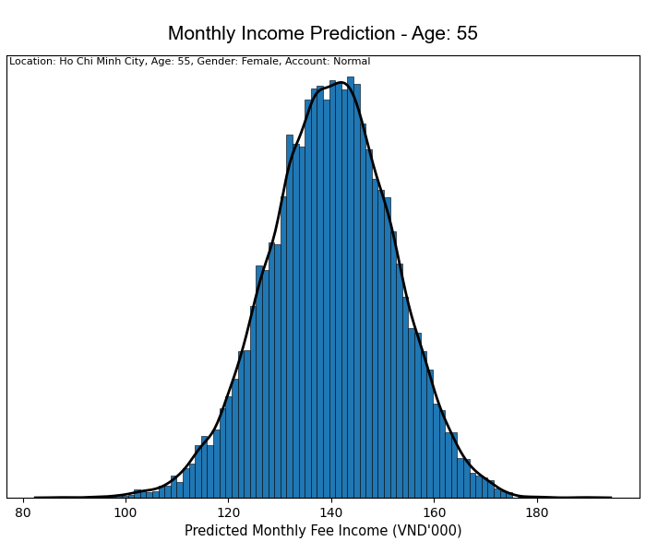
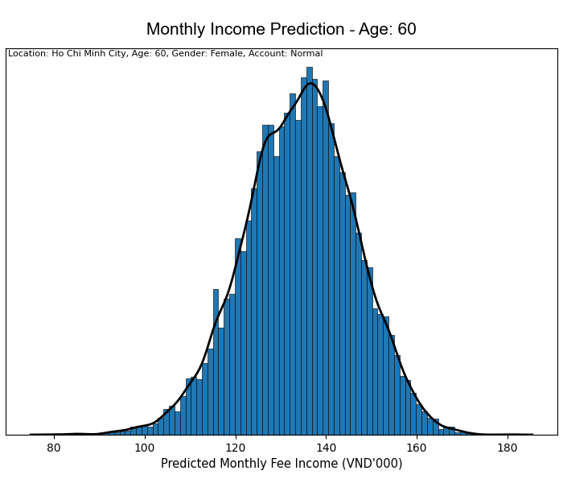
income PREDICTION ACCOUNT TYPE: normal , LOCATION: HO CHI MINH CITY, GENDER: Female
click to go back to guideline
click to go back to key findings

Slide 16
prediction result summary: Fee Income LOCATION: HO CHI MINH CITY, ACCOUNT TYPE: normal
click to go back to guideline
click to go back to key findings

Slide 17
MARGIN ACCOUNT

Slide 18
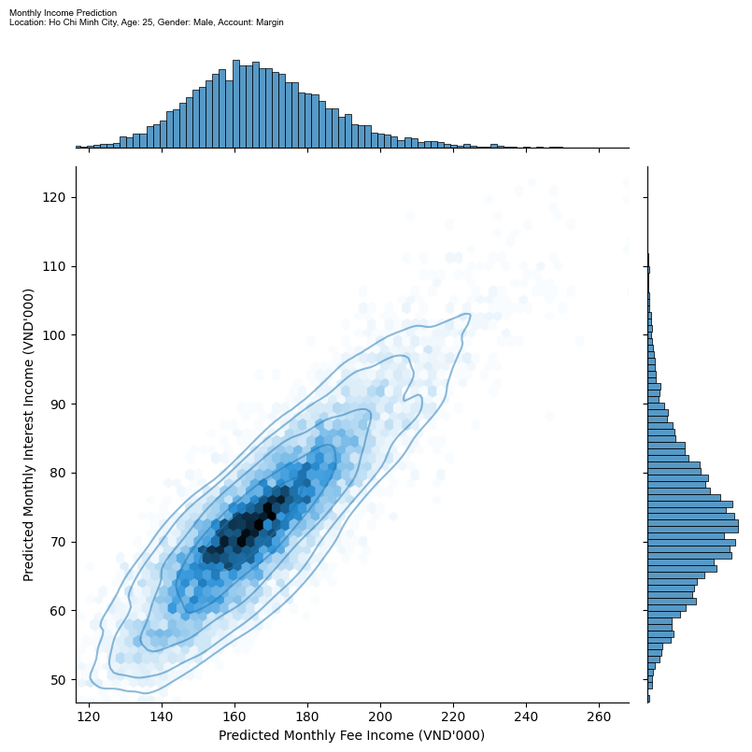
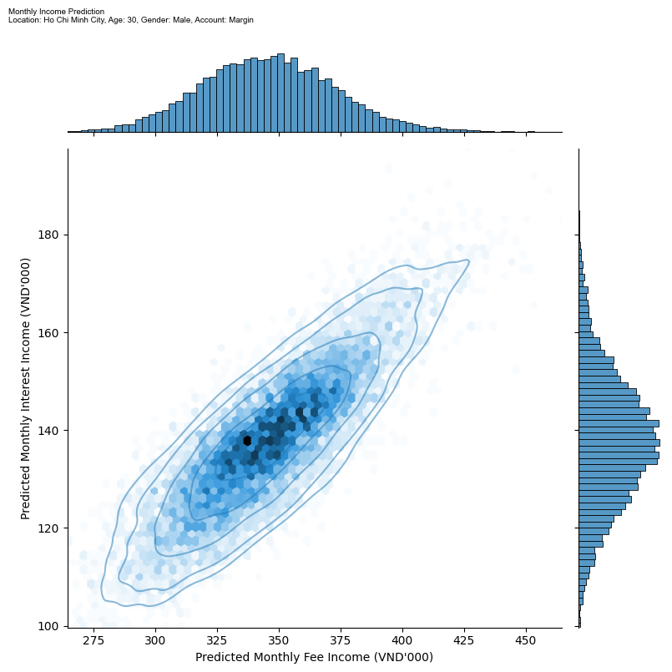
income PREDICTION ACCOUNT TYPE: MARGIN, LOCATION: HO CHI MINH CITY, GENDER: male
click to go back to guideline
click to go back to key findings
Age: 25
Age: 30

Slide 19
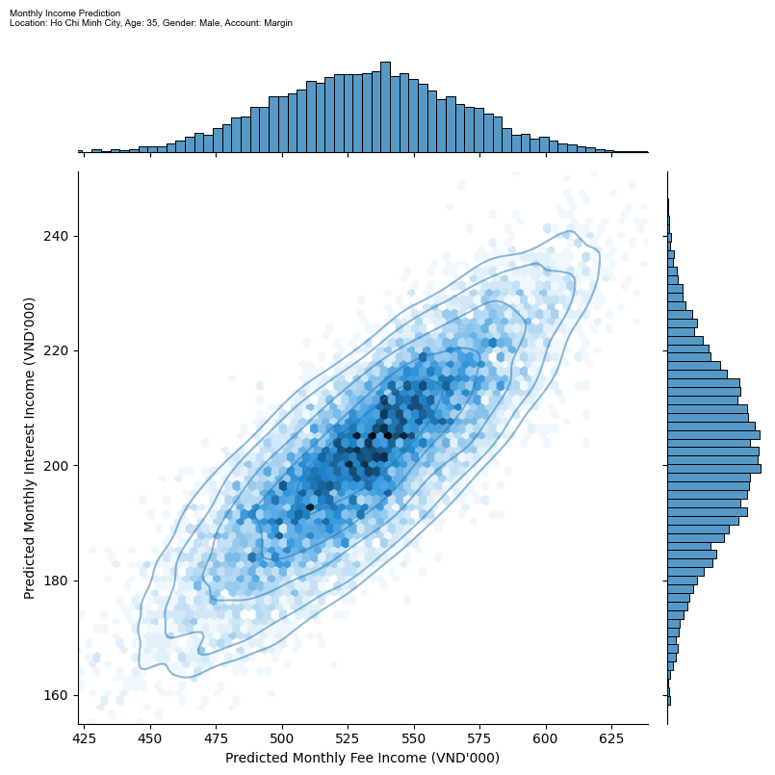
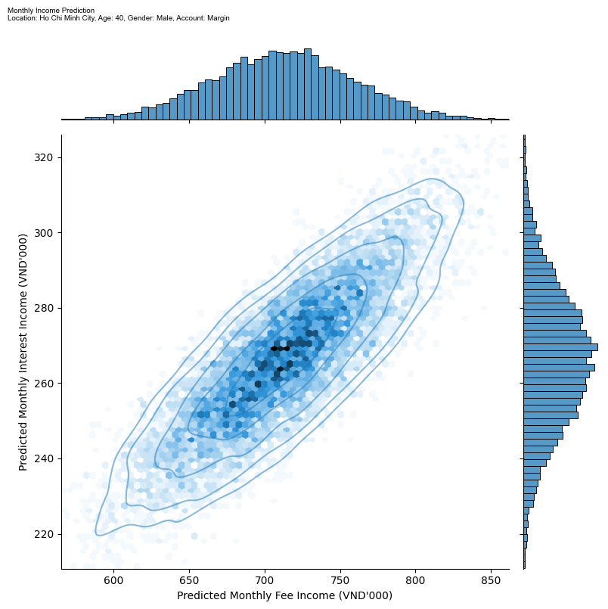
income PREDICTION ACCOUNT TYPE: MARGIN, LOCATION: HO CHI MINH CITY, GENDER: male
click to go back to guideline
click to go back to key findings
Age: 35
Age: 40

Slide 20
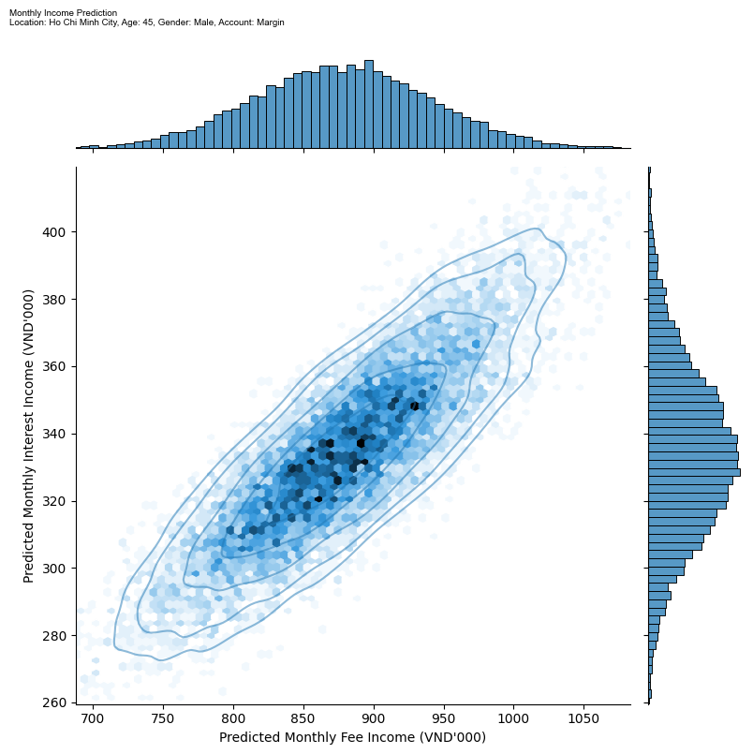
income PREDICTION ACCOUNT TYPE: MARGIN, LOCATION: HO CHI MINH CITY, GENDER: male
click to go back to guideline
click to go back to key findings
Age: 45
Age: 50

Slide 21
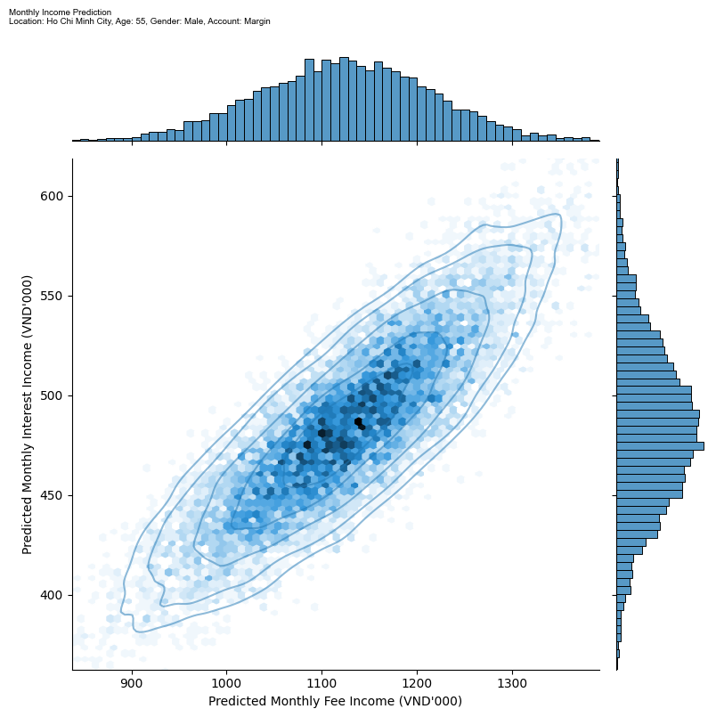
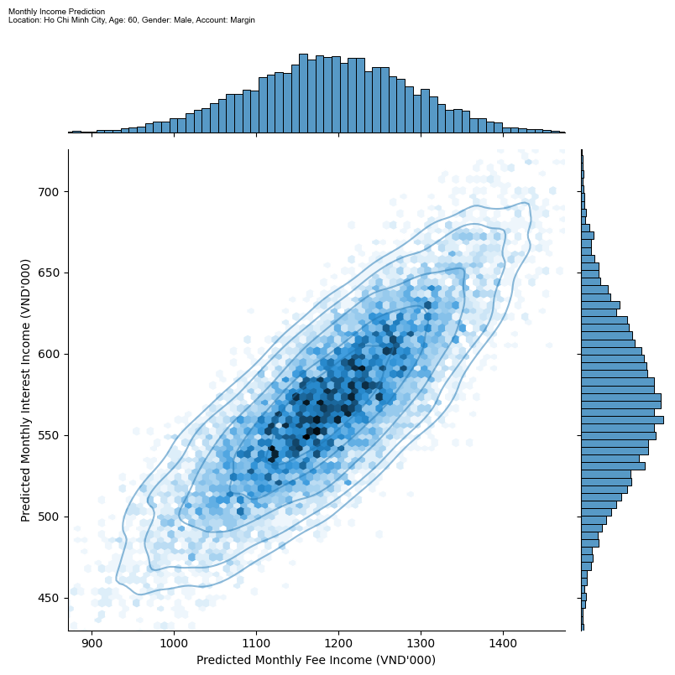
income PREDICTION ACCOUNT TYPE: MARGIN, LOCATION: HO CHI MINH CITY, GENDER: male
click to go back to guideline
click to go back to key findings
Age: 55
Age: 60

Slide 22
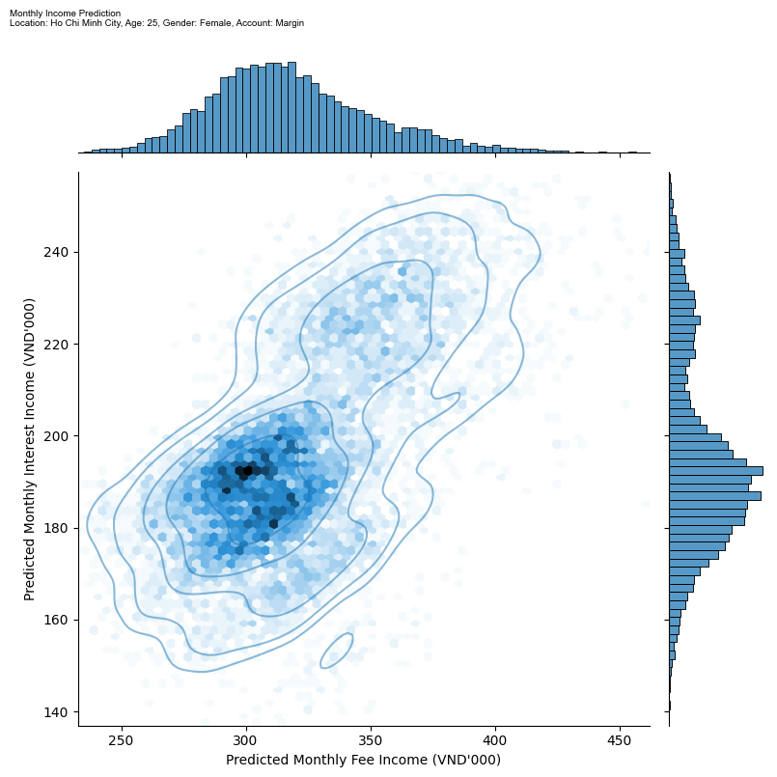
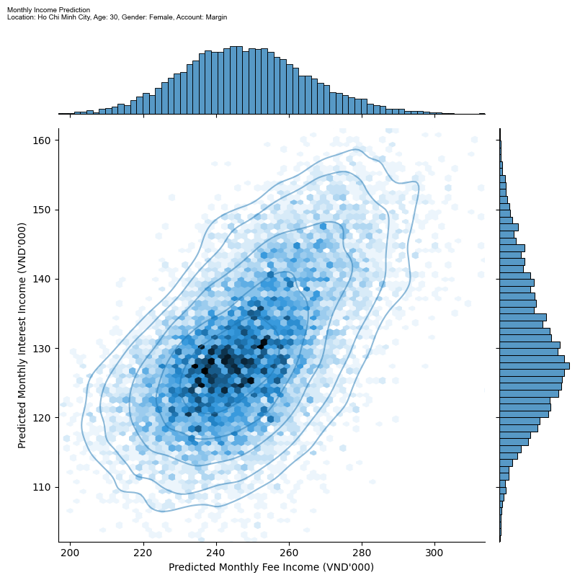
income PREDICTION ACCOUNT TYPE: MARGIN, LOCATION: HO CHI MINH CITY, GENDER: female
click to go back to guideline
click to go back to key findings
Age: 25
Age: 30

Slide 23
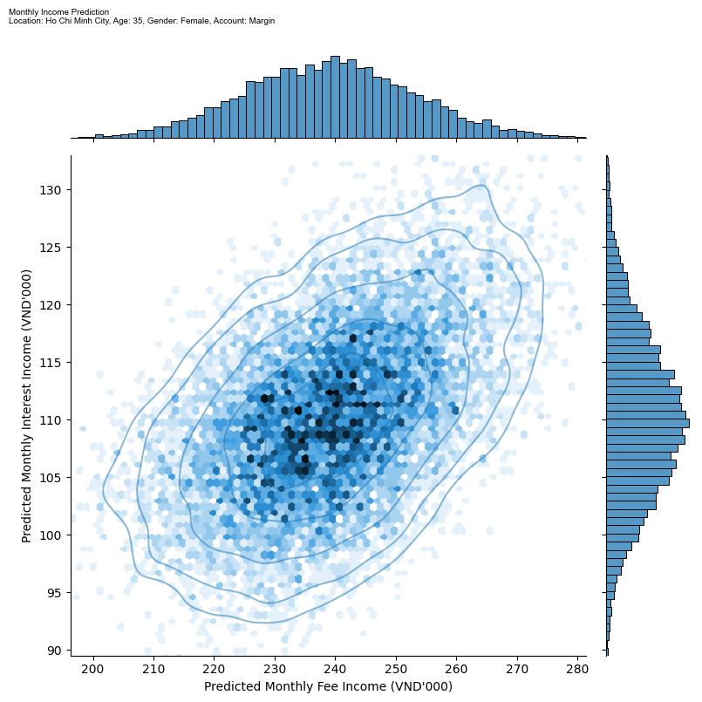
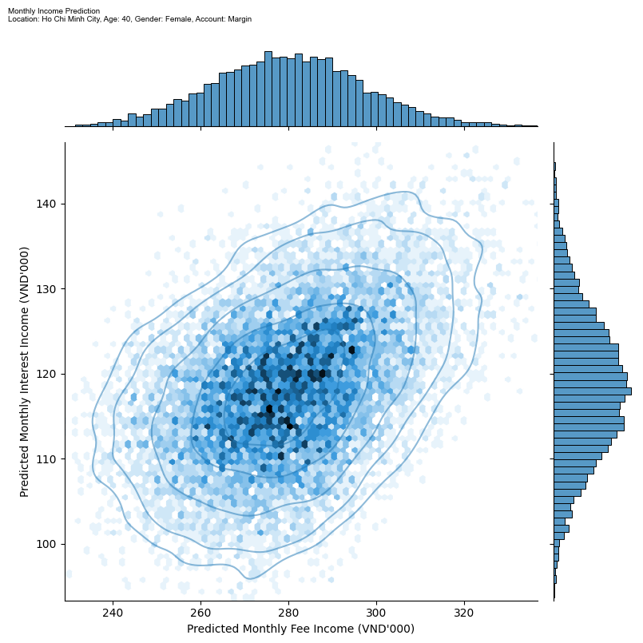
income PREDICTION ACCOUNT TYPE: MARGIN, LOCATION: HO CHI MINH CITY, GENDER: female
click to go back to guideline
click to go back to key findings
Age: 35
Age: 40

Slide 24
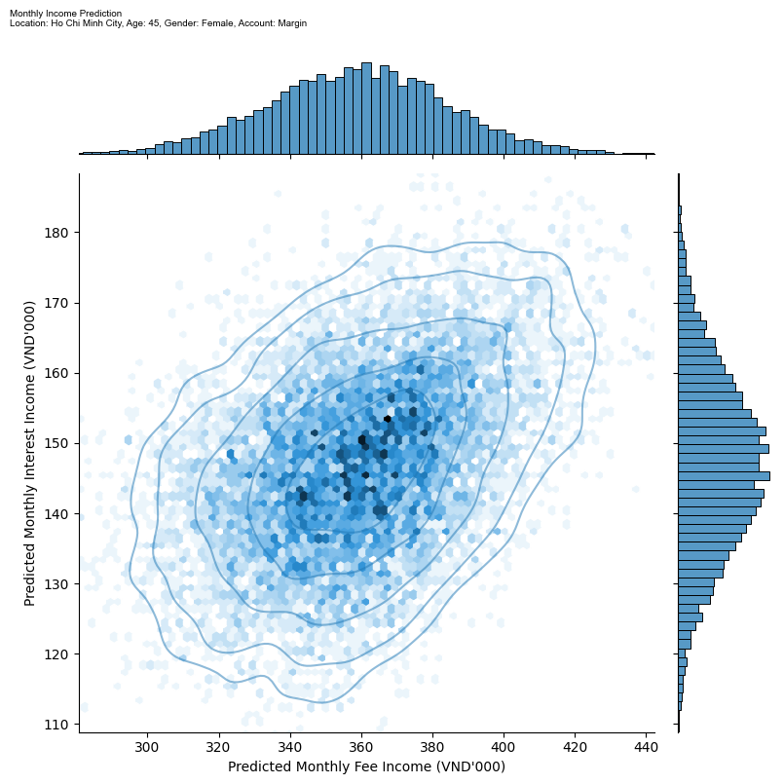

income PREDICTION ACCOUNT TYPE: MARGIN, LOCATION: HO CHI MINH CITY, GENDER: female
click to go back to guideline
click to go back to key findings
Age: 45
Age: 50

Slide 25
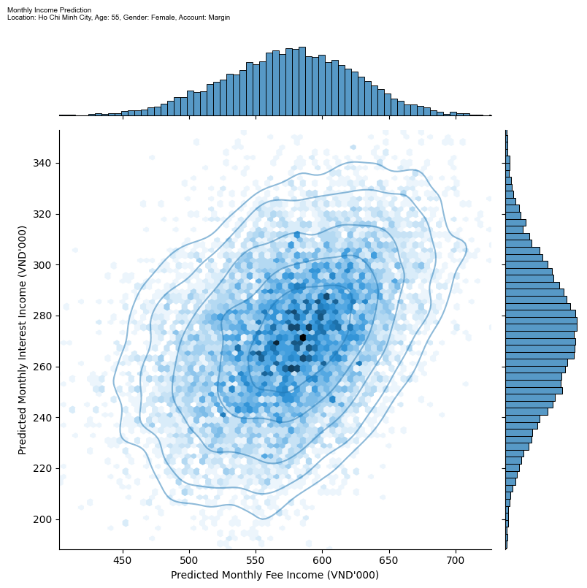
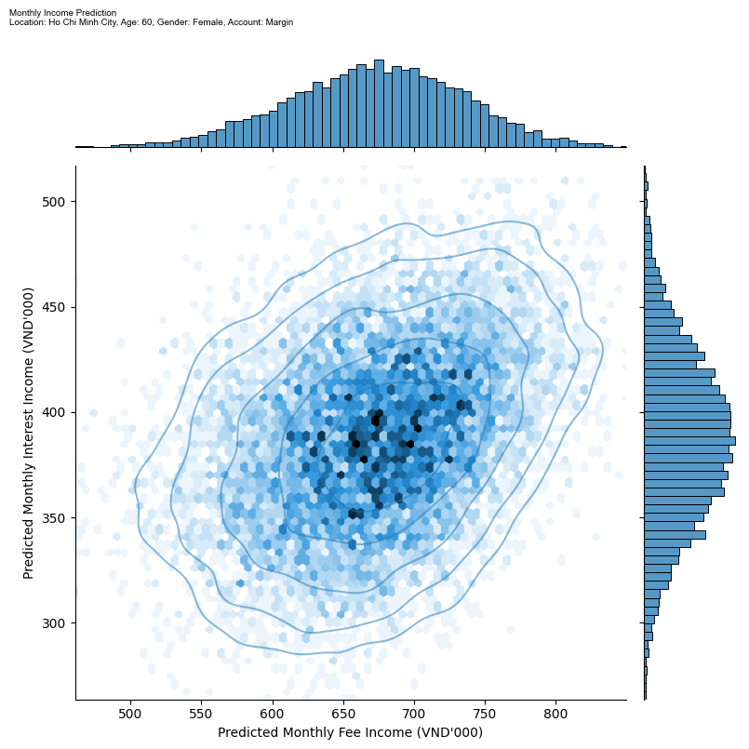
income PREDICTION ACCOUNT TYPE: MARGIN, LOCATION: HO CHI MINH CITY, GENDER: female
click to go back to guideline
click to go back to key findings
Age: 55
Age: 60

Slide 26
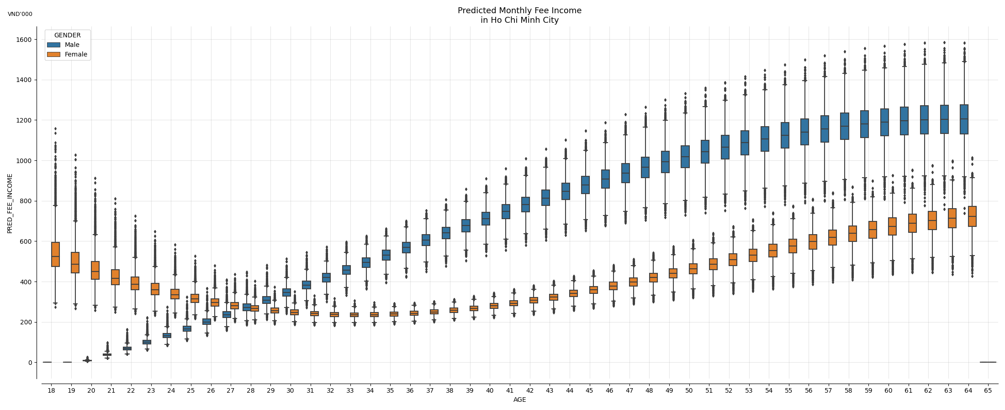
prediction result summary: Fee Income LOCATION: HO CHI MINH CITY, ACCOUNT TYPE: margin
click to go back to guideline
click to go back to key findings

Slide 27
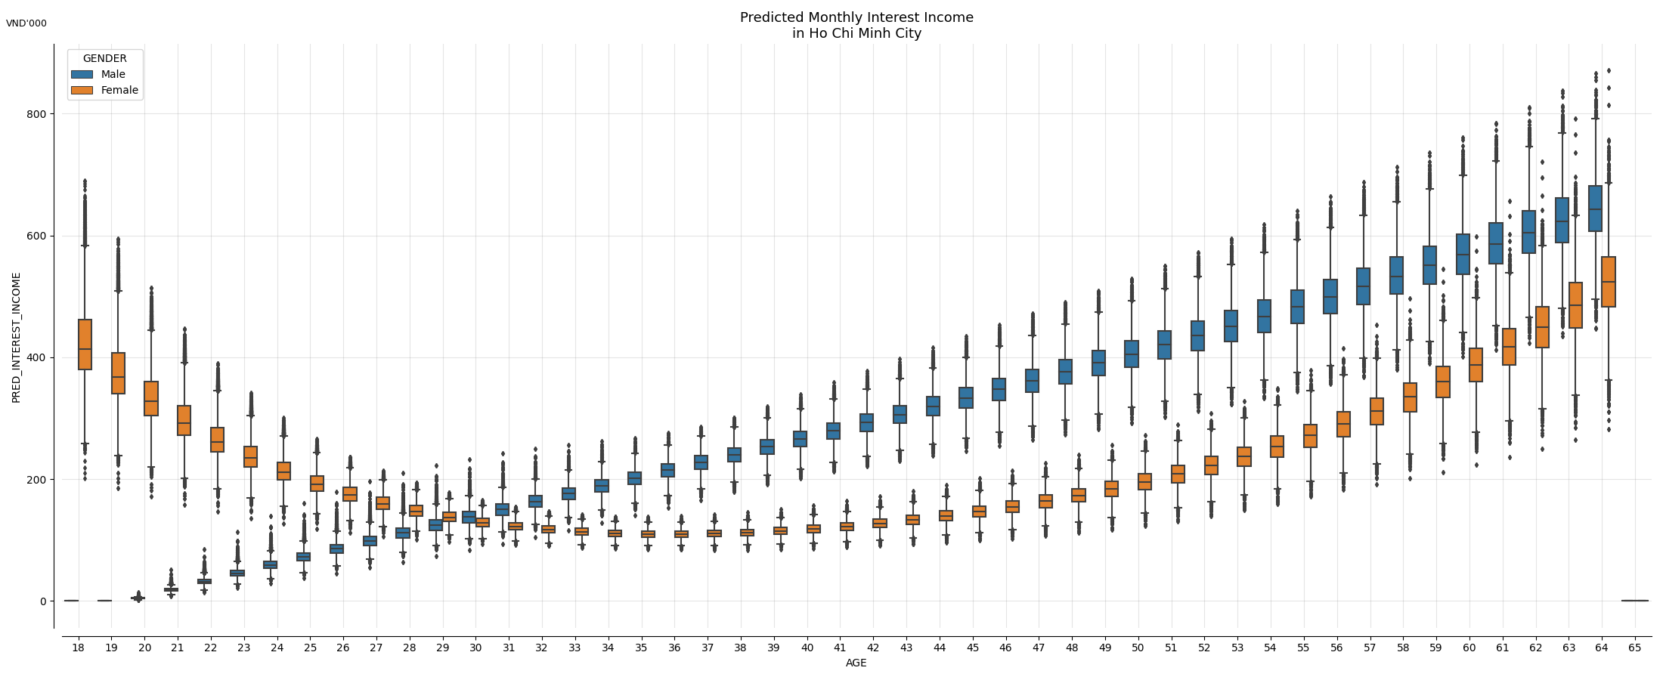
prediction result summary: interest income LOCATION: HO CHI MINH CITY, ACCOUNT TYPE: margin
click to go back to guideline
click to go back to key findings

Slide 28
RESULT OF HA NOI

Slide 29
NORMAL ACCOUNT

Slide 30
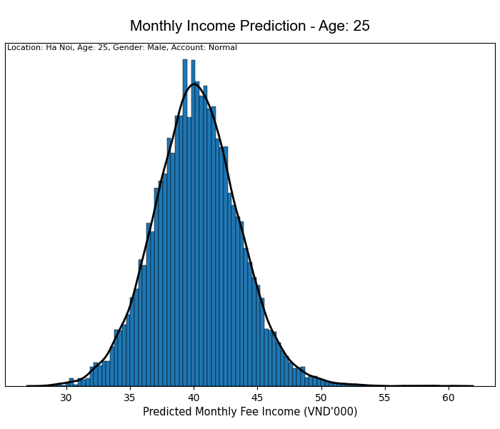
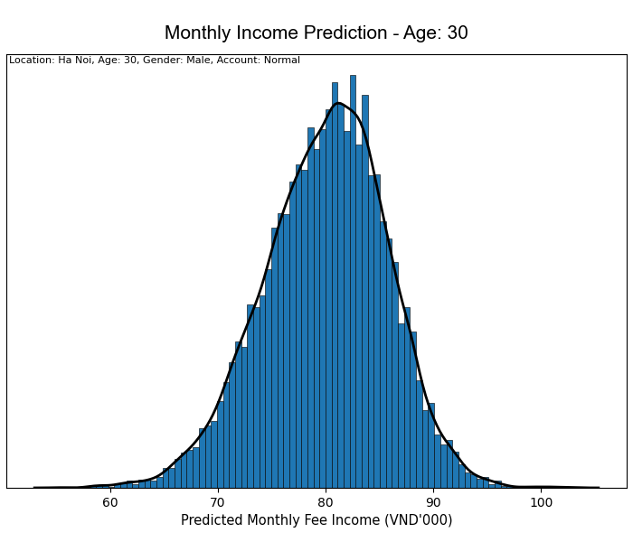
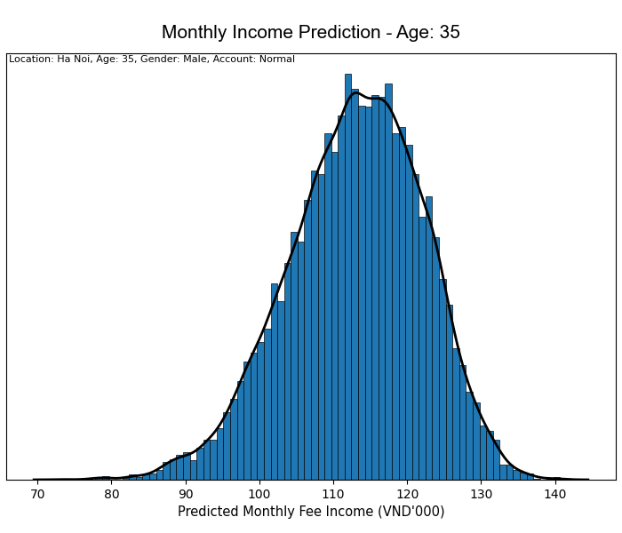
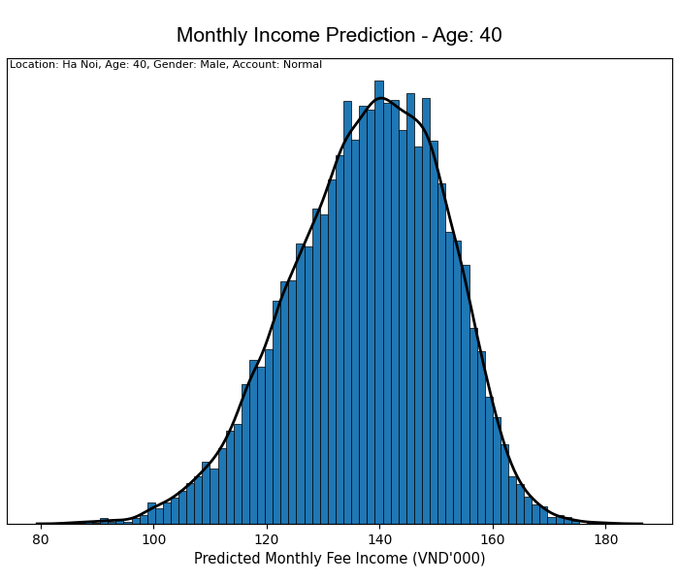
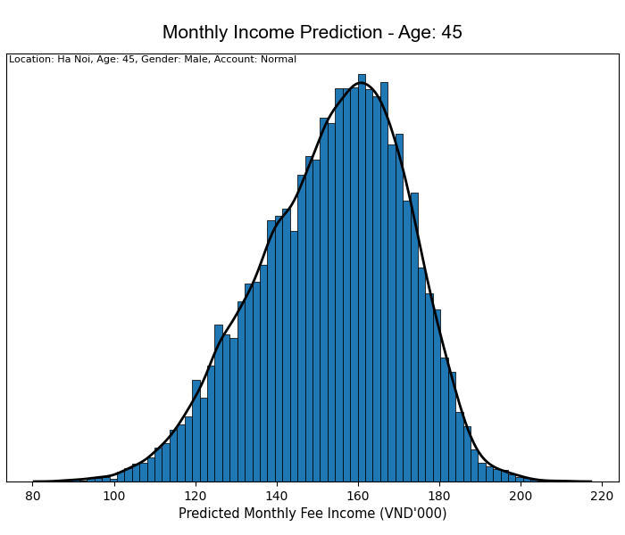
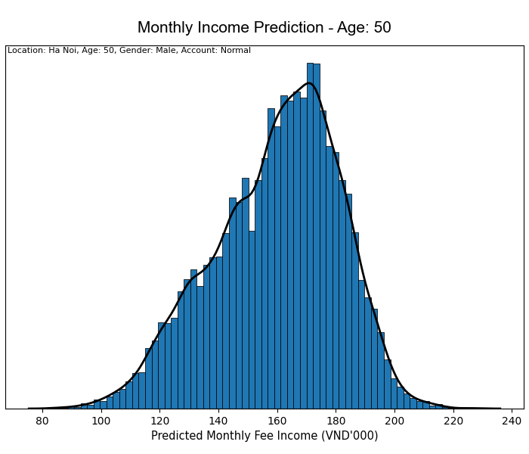
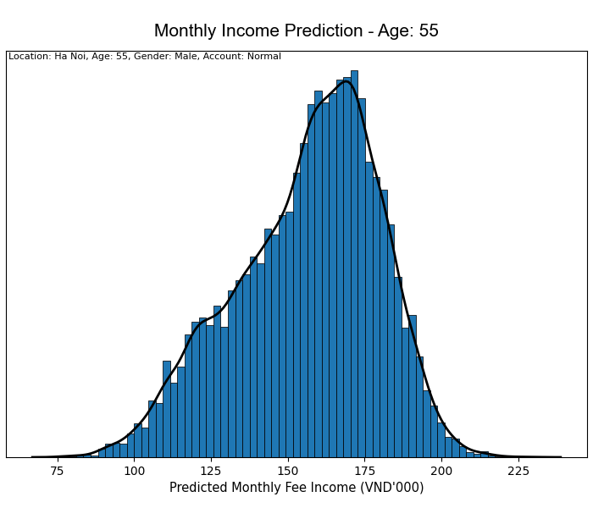
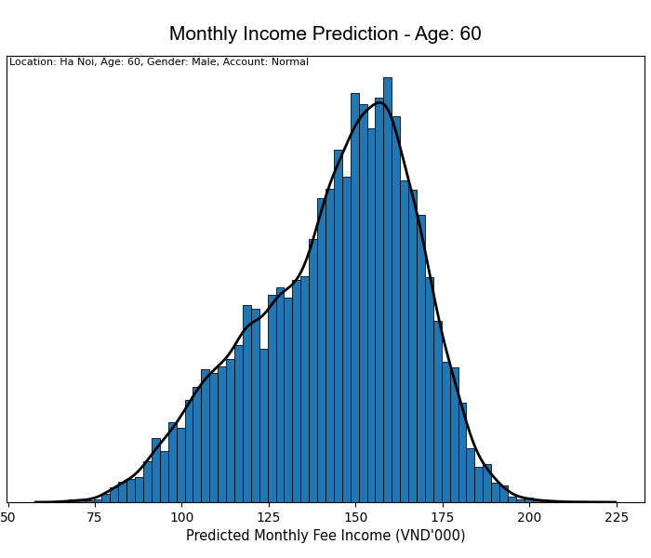
income PREDICTION ACCOUNT TYPE: normal , LOCATION: Ha noi, GENDER: male
click to go back to guideline
click to go back to key findings

Slide 31
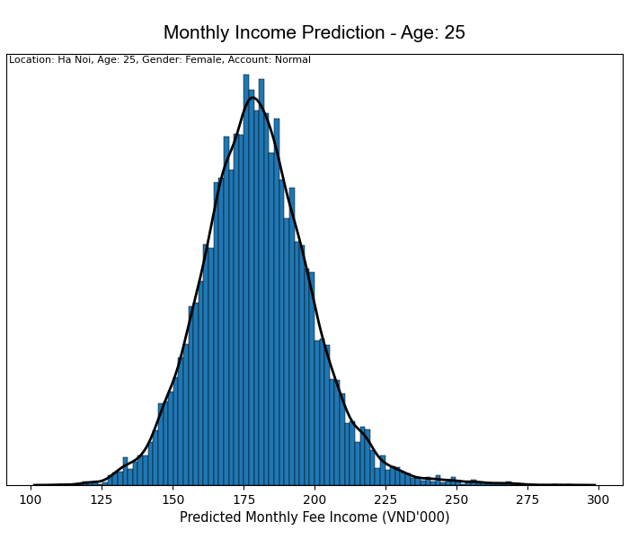
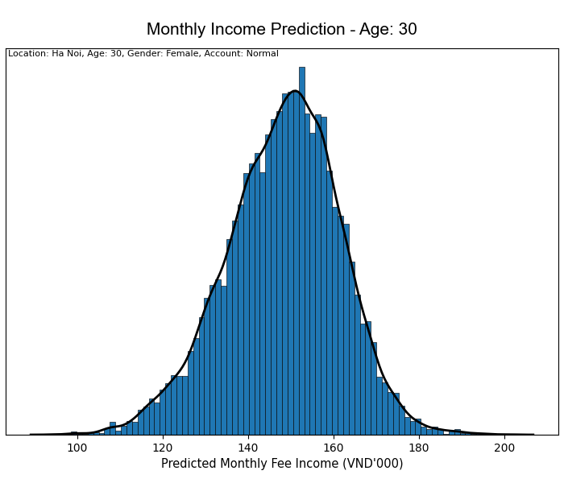
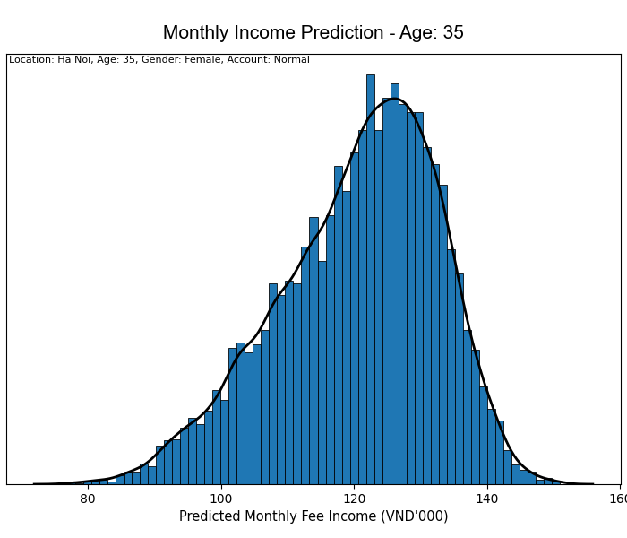
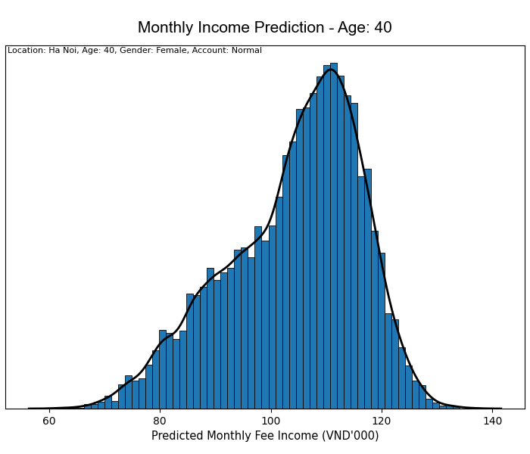
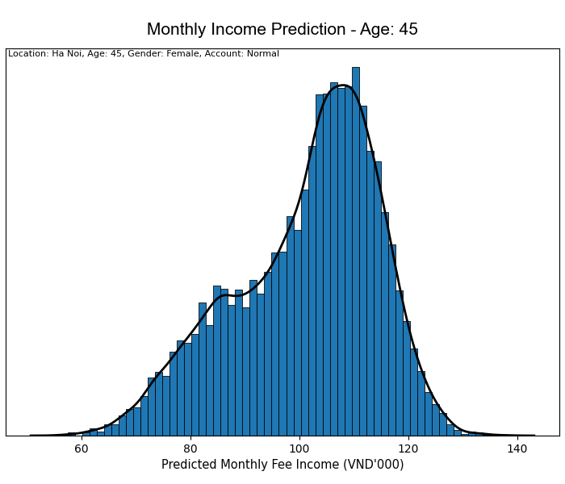



income PREDICTION ACCOUNT TYPE: normal , LOCATION: Ha noi, GENDER: Female
click to go back to guideline
click to go back to key findings

Slide 32

prediction result summary: Fee Income LOCATION: HA NOI, ACCOUNT TYPE: normal
click to go back to key findings

Slide 33
MARGIN ACCOUNT

Slide 34


income PREDICTION ACCOUNT TYPE: MARGIN, LOCATION: ha noi, GENDER: male
click to go back to guideline
click to go back to key findings
Age: 25
Age: 30

Slide 35


income PREDICTION ACCOUNT TYPE: MARGIN, LOCATION: HA NOI, GENDER: male
click to go back to guideline
click to go back to key findings
Age: 35
Age: 40

Slide 36


income PREDICTION ACCOUNT TYPE: MARGIN, LOCATION: HA NOI, GENDER: male
click to go back to guideline
click to go back to key findings
Age: 45
Age: 50

Slide 37


income PREDICTION ACCOUNT TYPE: MARGIN, LOCATION: HA NOI, GENDER: male
click to go back to guideline
click to go back to key findings
Age: 55
Age: 60

Slide 38


income PREDICTION ACCOUNT TYPE: MARGIN, LOCATION: HA NOI, GENDER: female
click to go back to guideline
click to go back to key findings
Age: 25
Age: 30

Slide 39


income PREDICTION ACCOUNT TYPE: MARGIN, LOCATION: HA NOI, GENDER: female
click to go back to guideline
click to go back to key findings
Age: 35
Age: 40

Slide 40


income PREDICTION ACCOUNT TYPE: MARGIN, LOCATION: HA NOI, GENDER: female
click to go back to guideline
click to go back to key findings
Age: 45
Age: 50

Slide 41

income PREDICTION ACCOUNT TYPE: MARGIN, LOCATION: HA NOI, GENDER: female
click to go back to guideline
click to go back to key findings
Age: 55
Age: 60

Slide 42

prediction result summary: Fee Income LOCATION: HA NOI, ACCOUNT TYPE: margin
click to go back to guideline
click to go back to key findings

Slide 43

prediction result summary: interest income LOCATION: HA NOI, ACCOUNT TYPE: margin
click to go back to guideline
click to go back to key findings

Slide 44
HAI PHONG

Slide 45
NORMAL ACCOUNT

Slide 46







income PREDICTION ACCOUNT TYPE: normal , LOCATION: HAI PHONG, GENDER: male
click to go back to guideline
click to go back to key findings

Slide 47







income PREDICTION ACCOUNT TYPE: normal , LOCATION: HAI PHONG, GENDER: Female
click to go back to guideline
click to go back to key findings

Slide 48

prediction result summary: Fee Income LOCATION: hai phong, ACCOUNT TYPE: normal
click to go back to guideline
click to go back to key findings

Slide 49
MARGIN ACCOUNT

Slide 50


income PREDICTION ACCOUNT TYPE: MARGIN, LOCATION: hai phong, GENDER: male
click to go back to guideline
click to go back to key findings
Age: 25
Age: 30

Slide 51


income PREDICTION ACCOUNT TYPE: MARGIN, LOCATION: hai phong, GENDER: male
click to go back to guideline
click to go back to key findings
Age: 35
Age: 40

Slide 52


income PREDICTION ACCOUNT TYPE: MARGIN, LOCATION: hai phong, GENDER: male
click to go back to guideline
click to go back to key findings
Age: 45
Age: 50

Slide 53


income PREDICTION ACCOUNT TYPE: MARGIN, LOCATION: hai phong, GENDER: male
click to go back to guideline
click to go back to key findings
Age: 55
Age: 60

Slide 54


income PREDICTION ACCOUNT TYPE: MARGIN, LOCATION: hai phong, GENDER: female
click to go back to guideline
click to go back to key findings
Age: 25
Age: 30

Slide 55


income PREDICTION ACCOUNT TYPE: MARGIN, LOCATION: hai phong, GENDER: female
click to go back to guideline
click to go back to key findings
Age: 35
Age: 40

Slide 56

income PREDICTION ACCOUNT TYPE: MARGIN, LOCATION: hai phong, GENDER: female
click to go back to guideline
click to go back to key findings
Age: 45
Age: 50

Slide 57

income PREDICTION ACCOUNT TYPE: MARGIN, LOCATION: hai phong, GENDER: female
click to go back to guideline
click to go back to key findings
Age: 55
Age: 60

Slide 58

prediction result summary: Fee Income LOCATION: hai phong, ACCOUNT TYPE: margin
click to go back to guideline
click to go back to key findings

Slide 59
prediction result summary: interest income LOCATION: hai phong, ACCOUNT TYPE: margin
click to go back to guideline
click to go back to key findings

Slide 60

Thank You
hiepdang@phs.vn

